Slide 1
Solving Problems – Excel Solver
Week 3, Day 11

Slide 2
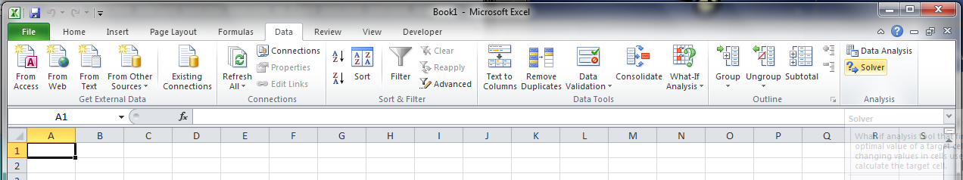
What-If Analysis
Excel has tools which will automatically vary the inputs to a problem to achieve a desired output
SOLVER

Slide 3
Solver
Solver is more powerful (and complicated) than Goal Seek
Solver can
Maximize or minimize functions
Set a given cell to a desired value
Perform constrained optimization (most important!)

Slide 4
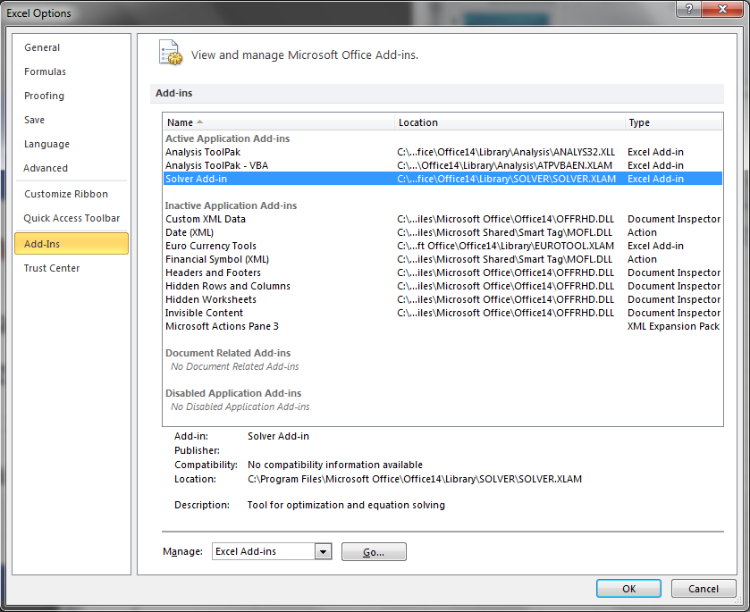
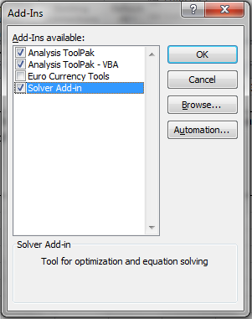
Solver
Solver is a another available data analysis tool
It may not be enabled by default in Excel!
From the File tab, click on Excel Options and choose Add-Ins on the left-hand side
If “Solver” not listed under “Active Add-Ins”, click “Go…” and check the box next to “Solver”, then click “OK”

Slide 5
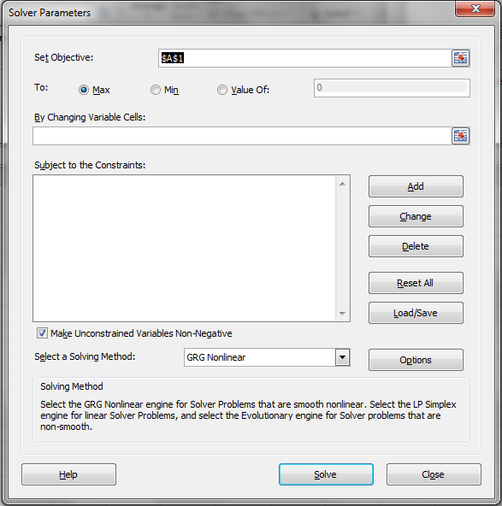


Performing Optimization with the Solver
Any optimization problem has an “objective function”
and usually has constraint functions
$$f\left(x,y,z,…\right)→min. (or max., or 0)$$
$$C_{1}\left(x,y,z,…\right)≤0 \\ C_{2}\left(x,y,z,…\right)>0 \\ etc.$$

Slide 6
Performing Optimization with the Solver
If all of the functions (both objective and constraint) are linear, then the problem can be solved with the “Simplex” method of “linear programming”
If the functions are non-linear, then more complex (and occasionally less than 100% effective) methods must be used, some of which are available in Solver
Gradient method
Iterative method
Monte-Carlo method

Slide 7

In-Class Exercise #4
Use the solver to repeat the analysis from In-Class Exercise #2. Find the value of x for which f(x)=0.
Remember that we limited (constrained) the value of x to be 0 ≤ x ≤ 1
$$f\left(x\right)=3e^{2x}−10=0$$

Slide 8
In-Class Exercise #5
Use the solver to find the minimum value of a function, f(x, y), with two independent variables.
Secondly, find the minimum value of f(x, y) subject to the constraint that y ≥ 1. (This is an optimization problem with a single constraint.)
$$f\left(x,y\right)=x^{2}+{\left(y−1\right)}^{2}+{\left(y−x\right)}^{2}+1$$

Slide 9
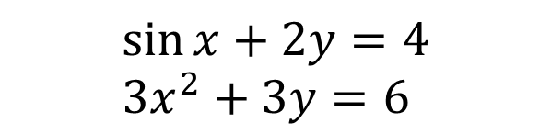
In-Class Exercise #6
Solve the following pair of simultaneous equations
First plot y(x) for both equations to obtain an approximate graphical solution
Then use the Solver to obtain an exact solution
$$\sin{x}+2y=4 \\ 3x^{2}+3y=6$$

Slide 10

In-Class Exercise #7
Use the Solver to find the solution to the following system of linear equations
$$3t+u+4v−w−23=0 \\ 3t+v+w−2=0 \\ −2u+v+w=0 \\ t+5u−2w+4=0$$

